Slide 1
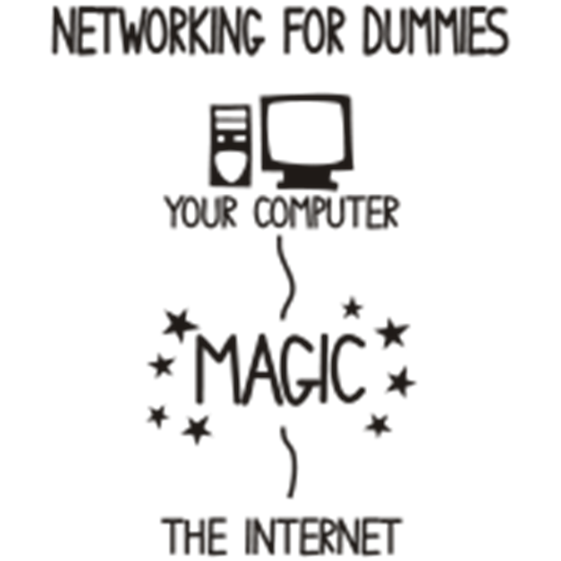
Introduction to Networks
Bob Marshall, MD MPH MISM FAAFP Program Director, MAMC/DoD Clinical Informatics Fellowship

Slide 2
Objectives
Review the basics of networking as an overview
Discuss the OSI model
Introduce the terminology of networking
Review the various hardware components of a network
Review the basics of network topology

Slide 3
Introduction 1 of 3
In its broadest sense, a network consists of two or more entities, or objects, sharing resources and information
A computer network consists of two or more computing devices that are connected in order to share the components of the network (its resources) and the information stored there
The most basic computer network (which consists of just two connected computers) can expand and become more usable when additional computers join and add their resources to those being shared

Slide 4
Introduction 2 of 3
In computer networks, computing devices exchange data with each other using connections (data links) between nodes
These data links are established over cable media such as wires or optic cables, or wireless media such as Wi-Fi
Network computer devices that originate, route and terminate the data are called network nodes
Nodes can include hosts such as personal computers, phones, servers as well as networking hardware

Slide 5
Introduction 3 of 3
Computer networks differ in the transmission medium used to carry their signals, communications protocols to organize network traffic, the network's size, topology, traffic control mechanism and organizational intent
The best-known computer network is the Internet

Slide 6
Clients and Servers
A server is a computer that holds content and services such as a website, a media file, or any number of applications (makes network resources available)
A client is a different computer, such as your laptop or cell phone, that requests to view, download, or use the content/network resources
Most requests and content delivery on networks are similar to, or are based on, a client to server relationship
On a network, the server can be located almost anywhere, and if the client has the address, it can access the content on the server

Slide 7
Network Relationships 1 of 2
Peer-to-Peer Network
The computers on the network communicate with each other as equals
Each computer is responsible for making resources available to every other computer on the network, and vice versa
Network security is a shared responsibility, or is managed via a router that services all of the computers on the network

Slide 8
Network Relationships 2 of 2
Pure Client/Server Network Relationship
All resources on the network are provided (hosted) by the server
All resources are centrally managed
None of the client computers share resources with other clients or the server
Clients are pure consumers of shared network resources

Slide 9
Pros/Cons for Peer-to-Peer
Pros
Less expensive
Easy to administer
No network operating system required
Built-in redundancy
Cons
User performance may be adversely impacted
Not very secure
Difficult to back up
Hard to maintain version control

Slide 10
Pros/Cons of Client/Server Network
Pros
Much more secure
Better performance
Centralized backup
Very reliable
Cons
Require professional administration
More hardware-intensive
More expensive

Slide 11
IP Addresses
In order to send and direct data across a network, computers need to be able to identify destinations and origins.
This identification is an IP - Internet Protocol - address.
An IP address is just a set of four numbers between 1 and 254, separated by dots
An IP address is similar to a street address, and they can be public or private

Slide 12
Other Terminology
OSI stands for Open Systems Interconnection. It is a reference model that specifies standards for communications protocols and also the functionalities of each layer
Protocol is the set of rules or algorithms which define the how two entities can communicate across the network, and different protocol are defined at each layer of OSI model
A few of the protocols are: TCP, IP, UDP, ARP, DHCP, FTP and so on

Slide 13
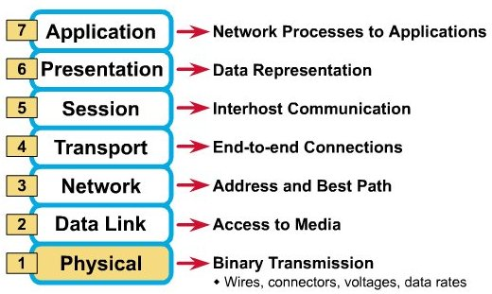
The OSI Model

Slide 14
Protocols 1 of 3
TCP: Transfer Control Protocol - one of the main protocols of the Internet protocol suite
It originated in the initial network implementation in which it complemented the Internet Protocol (IP)
Therefore, the entire suite is commonly referred to as TCP/IP
TCP provides reliable, ordered, and error-checked delivery of a stream of octets (bytes) between applications running on hosts communicating via an IP network

Slide 15
Protocols 2 of 3
FTP: File Transfer Protocol - a standard network protocol used for the transfer of computer files between a client and server on a computer network
FTP is built on a client-server model architecture and uses separate control and data connections between the client and the server
FTP users may authenticate themselves with a clear-text sign-in protocol, normally in the form of a username and password, but can connect anonymously if the server is configured to allow it

Slide 16
Protocols 3 of 3
DHCP: Dynamic Host Configuration Protocol - a network management protocol used on UDP/IP networks whereby a DHCP server dynamically assigns an IP address and other network configuration parameters to each device on a network so they can communicate with other IP networks
A DHCP server enables computers to request IP addresses and networking parameters automatically from the Internet service provider (ISP), reducing the need for a network administrator or a user to manually assign IP addresses to all network devices

Slide 17
Unique Network Identifiers 1 of 3
Host name: Each device in the network is associated with a unique device name known as Hostname
MAC Address (Media Access Control address): Also known as physical address, is the unique identifier of each host and is associated with the NIC (Network Interface Card)
MAC address is assigned to the NIC at the time of manufacturing
Length of the MAC address is : 12-digit/ 6 bytes/ 48 bits

Slide 18
Unique Network Identifiers 2 of 3
Port: the logical channel through which data can be sent/received to an application
Any host may have multiple applications running, and each application is identified using the port number on which they are running
Socket: The unique combination of IP address and Port number together are termed as Socket

Slide 19
Unique Network Identifiers 3 of 3
DNS Server: DNS stands for Domain Name System
DNS is basically a server which translate web addresses or URL (ex: www.google.com) into their corresponding IP addresses
ARP: Address Resolution Protocol
It is used to convert the IP address to its corresponding Physical Address(i.e.MAC Address)
ARP is used by the Data Link Layer to identify the MAC address of the Receiver’s machine

Slide 20
Packets 1 of 2
Most information in computer networks is carried in packets
A network packet is a formatted unit of data (a list of bits or bytes, usually a few tens of bytes to a few kilobytes long) carried by a packet-switched network
Packets are sent through the network to their destination
Once the packets arrive they are reassembled into their original message
Packets consist of two kinds of data: control information, and user data (payload)

Slide 21
Packets 2 of 2
The control information provides data the network needs to deliver the user data, for example: source and destination network addresses, error detection codes, and sequencing information
Typically, control information is found in packet headers and trailers, with payload data in between
With packets, the bandwidth of the transmission medium can be better shared among users than if the network were circuit switched

Slide 22
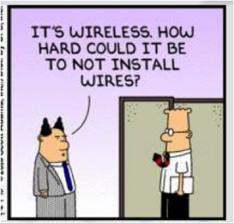
Network Nodes/Hardware

Slide 23
Network Interfaces
A network interface controller (NIC) is computer hardware that provides a computer with the ability to access the transmission media, and has the ability to process low level network information
The NIC responds to traffic addressed to a network address for either the NIC or the computer as a whole
In both Ethernet and wireless networks, each network interface controller has a unique Media Access Control (MAC) address—usually stored in the controller's permanent memory

Slide 24
Repeaters and Hubs 1 of 2
A repeater is an electronic device that receives a network signal, cleans it of unnecessary noise and regenerates it
The signal is retransmitted at a higher power level, or to the other side of an obstruction, so that the signal can cover longer distances without degradation
In most twisted pair Ethernet configurations, repeaters are required for cable that runs longer than 100 meters
With fiber optics, repeaters can be tens or even hundreds of kilometers apart

Slide 25
Repeaters and Hubs 2 of 2
A repeater with multiple ports is known as an Ethernet hub (most common - 24)
Repeaters work on the physical layer of the OSI model
Repeaters require a small amount of time to regenerate the signal
This can cause a propagation delay that affects network performance and may affect proper function
As a result, many network architectures limit the number of repeaters that can be used in a row
Hubs and repeaters in LANs have been mostly obsoleted by modern switches

Slide 26
Bridges
A network bridge connects and filters traffic between two network segments at the data link layer (layer 2) of the OSI model to form a single network
This breaks the network's collision domain but maintains a unified broadcast domain
Network segmentation breaks down a large, congested network into an aggregation of smaller, more efficient networks
Bridges come in three basic types: Local, Remote and Wireless

Slide 27
Switches 1 of 3
A network switch is a device that forwards and filters OSI layer 2 datagrams (frames) between ports based on the destination MAC address in each frame
A switch is distinct from a hub in that it only forwards the frames to the physical ports involved in the communication rather than all ports connected
It can be thought of as a multi-port bridge
It learns to associate physical ports to MAC addresses by examining the source addresses of received frames

Slide 28
Switches 2 of 3
Switches are the foundation of most business networks
A switch acts as a controller, connecting computers, printers, and servers to a network in a building or across multiple buildings
Switches allow devices on your network to communicate with each other, as well as with other networks, creating a network of shared resources
Switches make each network connection a private one

Slide 29
Switches 3 of 3
There are two basic types of switches to choose from: managed and unmanaged
An unmanaged switch works out of the box but can't be configured
Home-networking equipment typically offers unmanaged switches
A managed switch can be configured
One can monitor and adjust a managed switch locally or remotely, giving greater control over network traffic and access

Slide 30
Routers 1 of 2
A router is an internet working device that forwards packets between networks by processing the routing information included in the packet or datagram (Internet Protocol information from layer 3)
The routing information is often processed in conjunction with the routing table (or forwarding table)
A router uses its routing table to determine where to forward packets
A destination in a routing table can include a "null" interface

Slide 31
Routers 2 of 2
Routers connect multiple networks together
They also connect computers on those networks to the Internet
Routers enable all networked computers to share a single Internet connection
A router acts a dispatcher, analyzing data being sent across a network, choosing the best route for data to travel, and sending it on its way
Routers can come with a firewall, a virtual private network (VPN), or an Internet Protocol (IP) communications system

Slide 32
Modems
Modems (MOdulator-DEModulator) are used to connect network nodes via wire not originally designed for digital network traffic, or for wireless.
To do this one or more carrier signals are modulated by the digital signal to produce an analog signal that can be tailored to give the required properties for transmission

Slide 33
Firewalls
A firewall is a network device for controlling network security and access rules
Firewalls are typically configured to reject access requests from unrecognized sources while allowing actions from recognized ones
The vital role firewalls play in network security grows in parallel with the constant increase in cyber attacks

Slide 34
Access Points 1 of 2
An access point allows devices to connect to the wireless network without cables
An access point acts like an amplifier for the network
While a router provides the bandwidth, an access point extends that bandwidth so that the network can support many devices, and those devices can access the network from farther away

Slide 35
Access Points 2 of 2
An access point does more than simply extend Wi-Fi
It can also give useful data about the devices on the network, provide proactive security, and serve many other practical purposes
Access points support different IEEE standards
The standards operate on varying frequencies, deliver different bandwidth, and support different numbers of channels

Slide 36
Servers
A server is any computer that performs network functions for other computers
These functions fall into several categories, including the following:
File and print servers
Application servers
Email servers
Networking servers
Internet servers
Remote access servers

Slide 37
Distinguishing features of servers
Built-in redundancy with multiple power supplies and fans ( for example) to keep the server running if something breaks
Special high-performance designs for disk subsystems, memory and network subsystems
Special monitoring software and hardware it keeps close watch on the health of the server

Slide 38
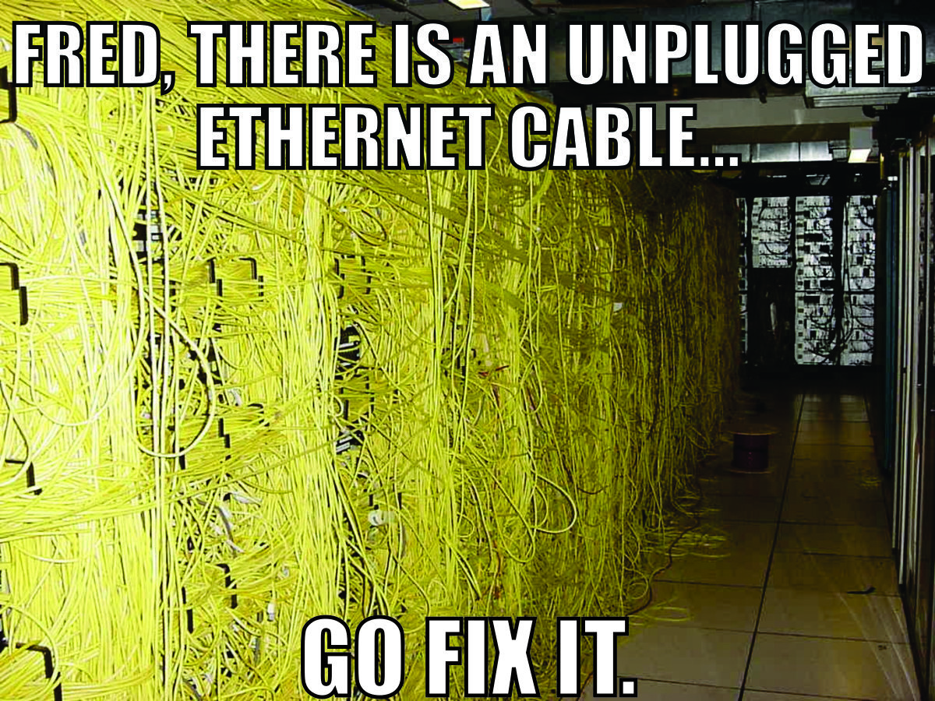
Network Topology

Slide 39
Ethernet
A type of networking protocol-it defines the types of cables and connections that are used to wire computers, switches, and routers together.
Most often Ethernet cabling is Category 5 or 6, made up of twisted pair wiring similar to phone cables
Widely adopted family of transmission media used in local area network (LAN) technology
The media and protocol standards that enable communication between networked devices over Ethernet are defined by IEEE 802.3

Slide 40
Coaxial Cable
The cables consist of copper or aluminum wire surrounded by an insulating layer (typically a flexible material with a high dielectric constant), which itself is surrounded by a conductive layer
The insulation helps minimize interference and distortion
Transmission speed ranges from 200 million bits per second to more than 500 million bits per second

Slide 41
ITU-T G.hn
Uses existing home wiring (coaxial cable, phone lines and power lines) to create a high-speed (up to 1 Gigabit/s) local area network

Slide 42
Twisted Pair 1 of 3
The most widely used medium for all telecommunication
Twisted-pair cabling consist of copper wires that are twisted into pairs
Ordinary telephone wires consist of two insulated copper wires twisted into pairs
Computer network cabling (wired Ethernet as defined by IEEE 802.3) consists of 4 pairs of copper cabling that can be utilized for both voice and data transmission

Slide 43
Twisted Pair 2 of 3
The use of two wires twisted together helps to reduce crosstalk and electromagnetic induction
The transmission speed ranges from 2 million bits per second to 10 billion bits per second
Twisted pair cabling comes in two forms: unshielded twisted pair (UTP) and shielded twisted-pair (STP)

Slide 44
Twisted Pair 3 of 3
The most common type of twisted-pair cable, used for most LANs, is Category 5, also called Cat-5
Cat-5 cable is used to support 100Base-T and 1000Base-T Ethernet networks
Both Cat-5E and Cat-6 cables are essentially the same as Cat-5, but they meet higher quality specifications to handle faster network speeds
Both are backward-compatible with prior network types

Slide 45
Optical Fiber 1 of 2
Glass fiber
It carries pulses of light that represent data
Some advantages of optical fibers over metal wires are very low transmission loss and immunity from electrical interference
Optic fibers can be used for long runs of cable carrying very high data rates, and are used for undersea cables to interconnect continents

Slide 46
Optical Fiber 2 of 2
There are two types of transmission of fiber optics, Single-mode fiber (SMF) and Multimode fiber (MMF)
Single-mode fiber has the advantage of being able to sustain a coherent signal for dozens or even a hundred kilometers
Multimode fiber is cheaper to terminate but is limited to a few hundred or even only a few dozens of meters, depending on the data rate and cable grade

Slide 47
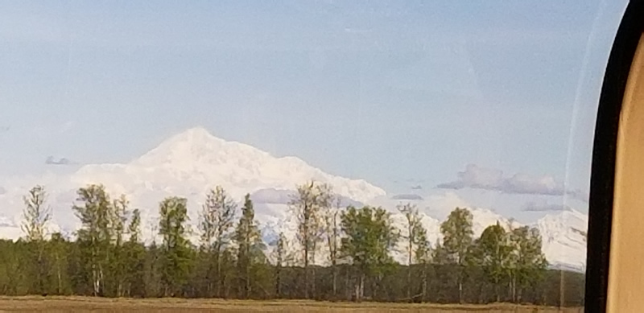
Questions???

Slide 48
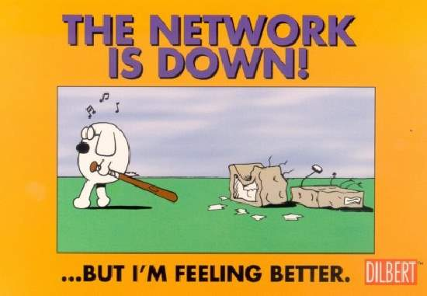
Back-up Slides

Slide 49
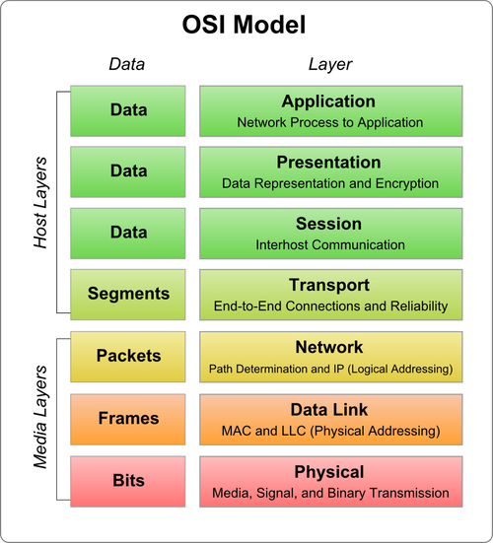

Slide 50
OSI Model – Layer 1– Physical Layer
Defines the properties of the physical medium used to make a network connection
Can either be a tangible physical medium (network cable) or radio waves
Includes any devices that make up the physical connection between two network computers (routers, switches, satellite antennas etc.)
Can be point-to-point, multipoint, half duplex (one direction at a time) or full-duplex (both directions simultaneously)

Slide 51
OSI Model – Layer 2 – Data-Link Layer
Define standards the design meeting to the pits carried by the physical layer
Establishes a reliable protocol through the physical layers of the network layer (Layer 3) can transmit its data
Typically includes error detection and correction to ensure a reliable data stream
The data elements carried by the data link layer are called frames

Slide 52
OSI Model – Layer 2 – Data-Link Layer cont
Examples of frame types include X.25 and 802.X
The data link layer is usually subdivided into two sub layers: the logical Link control (LLC) and media access control (MAC) sub layers
The MAC sublayer handles frame assembly and disassembly, error detection and correction, and addressing
The two most common MAC protocols are 802.3 ethernet and 802.5 Token Ring, but also include 802.11 Wireless and 802.7 Broadband

Slide 53
OSI Model – Layer 3 – Network Layer
This is where a lot of action goes on most networks
Defines how data packets get from one point to another on a network and what goes into each packet
Uses different packet protocols, such as Internet Protocol (IP) and Internet Protocol Exchange (IPX), which includes source and destination routing information

Slide 54
OSI Model – Layer 3 – Network Layer cont
Is most important when a network connection pass through one or more routers, which examine each packet and send the package to the proper destination based on the source and destination addresses
Breaking the network layer (a.k.a. the packet layer) into a separate layer from the physical and datalink layers means the protocols defined in this layer can be carried over any variations of the lower layers

Slide 55
OSI Model – Layer 4 – Transport Layer
Manages the flow of information from one network node to another
Ensures that the packets are decoded in the proper sequence and that all packets are received
Also identifies each computer or node on a network uniquely
The transport layer is the first layer where differences between network operating systems occur
Transport layer protocol examples include Transmission Control Protocol (TCP) and Sequenced Packet Exchange (SPX) , used with IP and IPX respectively

Slide 56
OSI Model – Layer 5 – Session Layer
Defines the connection from a user computer to a network server, or from a pure computer on a network to another peer computer
These virtual connections are called sessions, and include negotiation between the client and host (or peers) about flow control, transaction processing, transfer abuser information and authentication to the network
They are called sessions because they set up connections that persist for some period of time

Slide 57
OSI Model – Layer 6 – Presentation Layer
Takes the data supplied by the lower level layers and transforms it so it can be presented to the system (as opposed to presenting the data to the user, which is handled outside the OSI model)
The functions that take place at the presentation layer can include data compression and decompression, as well as data encryption and decryption

Slide 58
OSI Model – Layer 7 – Application Layer
Controls how the operating system and its applications interact with the network
Applications that you use are not part of the application layer, but they benefit from the work that goes on there
Defines how applications can work with the network (i.e., be network aware)

